Slide 1
Business Analytics: Week 9
Brief Review of Hypothesis Testing
Chi-Square Test of Independence & Fitting Distributions
Correlation & Linear Regression
Problem Set #7 as time allows

Slide 2
For Next Week
Quiz 6
Problem Set 7

Slide 3
Tests on Means
Against a known reference point:
Eg., true mean equals a specific number, say 180
Use Z-test if std. dev of underlying population is known
Otherwise use T-test
Z-test can be substituted for T-test of sample size is > 30
To test means of two different samples against each other:
Use Two-Sample T-test tool from Excel

Slide 4
Tests on Variance
Against a specified number---use chi square test of variance
chidist
chiinv
Two samples---use F-test tool

Slide 6
Chi-Square Test for Independence Example
A random sample of 100 firms is taken. For each firm, we record whether the company made or lost money in its most recent fiscal year, and whether the firm is a service or non-service company. A 2 X 2 contingency table summarizes the data.
 | Industry Type
 | Service | Non-service |  |  | Total
profit | 42 |  | 18 |  | 60
loss | 6 |  | 34 |  | 40
Total | 48 |  | 52 |  | 100

Slide 8
 | Industry Type
 | Service | Non-service |  |  | Total
profit | 42 |  | 18 |  | 60
loss | 6 |  | 34 |  | 40
Total | 48 |  | 52 |  | 100
Probability of profit = 0.6
Probability of Loss = 0.4
Probability of Service = 0.48
Probability of Non-Service = 0.52
Assuming Independence:
P{profit and Service} = P{profit} x P{service} = 0.6 x 0.48 = 0.288
Expected number in the corresponding cell is 100 x 0.288 = 28.8
We can go through similar calculations for the other three cells. Doing so, we get the table of expected counts shown on the next slide:

Slide 9
Actual and Expected Counts
 | Industry Type
 | Service | Non-service |  |  | Total
profit | 42 |  | 18 |  | 60
loss | 6 |  | 34 |  | 40
Total | 48 |  | 52 |  | 100
<= Actual Counts
 | Industry Type
 | Service | Non-service |  |  | Total
profit | 28.8 |  | 31.2 |  | 60
loss | 19.2 |  | 20.8 |  | 40
Total | 48 |  | 52 |  | 100
Expected Counts = >

Slide 11
Chi-Test: Murder by Sex Example (1995 FBI Crime Statistics)

Slide 12
Chi-Test: Crimes by Month Example – are # crimes independent of month?

Slide 13
Using the Chi-Test in Fitting Distributions
Example: Horse-kick deaths in the German Army

Slide 14
Death from Horse Kicks in the German Army
The German mathematician, Bortkewitsch, published a book in 1898 (The Law of Small Numbers) analyzing deaths from horse kicks in the German Army over a 20 year period.
He claimed that the data fit a “Poisson” distribution very nicely.
Does it Really?

Slide 15
Here is the Data
The data is from 14 Army corps over 20 years, giving a total of 280 observations:
Note that there are a total of 196 deaths in the 280 observations, giving an estimate for the expected # of deaths (per observation) equal to 0.7
# Deaths | Actual # Observations
0 | 144
1 | 91
2 | 32
3 | 11
4 | 2
5+ | 0

Slide 16
How Can We Determine if the Data Fits a Poisson Distribution?
Here’s One Idea:
Figure out the EXPECTED # of observations under the assumption that the Poisson Distribution idea really holds
Compare the ACTUAL numbers to the EXPECTED numbers using a chi-square test (eg, the chitest function in Excel)
If chi-test reports a large p-value, we would fail to reject the null hypothesis that the data fit a Poisson distribution

Slide 17
How Can We Figure out the Expected Numbers?
If X follows a Poisson Distribution,
P{X = k} = Poisson(k, p, 0)
Where p = expected # occurrences in a single observation period
For Prussian horse-kick deaths, p = 0.7
Expected # of observations for a value of k then is given by:
(# observations) x P{X = k}
For Prussian horse-kick deaths
Expected # = 280 x Poisson(k,0.7,0)

Slide 18
Here are the Actuals and Expecteds
# Deaths | Actual # Observations | Expected # Observations (approx)
0 | 144 | 139
1 | 91 | 97
2 | 32 | 34
3 | 11 | 8
4 | 2 | 1.4
5+ | 0 | 0.2

Slide 20
Using the Chi-Square Test

Slide 21
Key Learning Point
We can test to see if data fit a given distribution by using the chi-square test
Need to compare actuals to expecteds
For continuous distributions (eg, normal) use a discrete (histogram) approximation

Slide 22
Chi-Test: Crimes by Month Example – are # crimes independent of month?

Slide 23
Another Way of Viewing This: Do the data come from a Uniform Distribution
Expected numbers if crimes by month follow a Uniform Distribution = total #/12
Chitest returns a p-value of < 0.05, so we can reject the hypothesis that crimes by month follow a Uniform Distribution

Slide 24
Correlation & Linear Regression

Slide 25
Summarizing Bivariate Data
Example: A data set from 44 school districts in New Jersey consisted of observations on x = dollar spent per student and y = average SAT score:
x 7750 9900 10870 12080 …
y 878 893 966 950
What is the general nature of the relationship between expenditure per pupil and average SAT score?

Slide 26
Correlation
We are interested in how two or more attributes of individuals or objects in a population are related to one another.
A scatterplot of bivariate numerical data gives a visual impression how strongly x and y values are related.
A correlation coefficient is a quantitative assessment of the strength of relationship between x and y.
See Correlation Spreadsheet

Slide 27
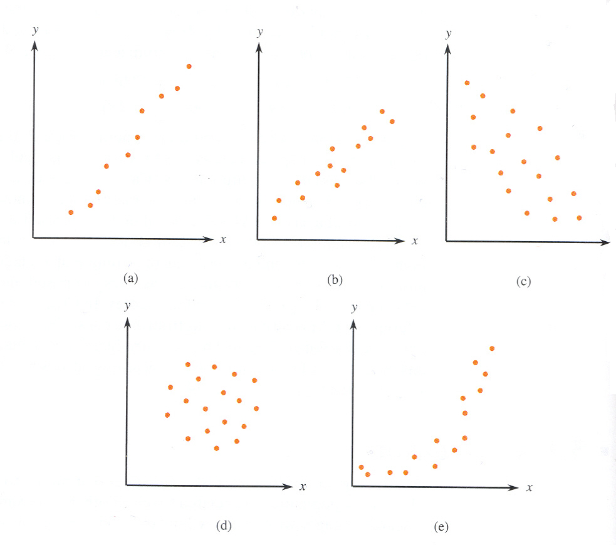
Scatterplots
illustrate
various
types of
relationship:
(a) Positive
linear relation
(b) Positive
linear relation
(c) Negative
linear relation
(d) No relation
(e) Curved
relation

Slide 28
Pearson’s Sample Correlation Coefficient
Example: For six primarily undergraduate public universities in California with enrollments, six year graduation rates and student-related expenditure per-full time student for 2003 were reported.
 | x (Student- Related Expenditure) | y (Graduation Rate) | z_{x} | z_{y} | z_{x}z_{y}
1 | 8011 | 64.6 | 0.30 | 1.64 | 0.50
2 | 7323 | 53.0 | - 0.80 | 0.59 | - 0.48
3 | 8735 | 46.3 | 1.47 | - 0.02 | - 0.02
4 | 7548 | 42.5 | - 0.44 | - 0.36 | 0.16
5 | 7071 | 38.5 | - 1.21 | - 0.72 | 0.87
6 | 8248 | 33.9 | 0.68 | - 1.14 | - 0.78

Slide 29
correlation coefficient r: see correlation spreadsheet
The value of r is between –1 and +1. An r near +1 indicates a substantial positive relationship, whereas an r near –1 suggests a substantial negative relationship.
r = 1 only when all the points in a scatterplot of the data lie exactly on a straight line with positive (upward) slope. r = –1 only when all the points lie exactly on a straight line with negative (downward) slope.
The value of r does not depend on which of the two variables is considered x and which is considered y.
The value of r does not depend on the unit of measurement for either variable.
The value of r is measure of the extent which x and y are linearly related.

Slide 30
Example: Relations between hours worked and GPA
How strong is the relationship between hours students work and their GPA?
528 students were selected with x = grade point average and y = time spent working at a job (in hours per week). The study reported that the correlation coefficient r = – 0.08.
Is there a tendency for those who work more to have lower GPA?
Answer: Linear relationship extremely weak. There is a very slight
tendency for those who work more to have lower grades.

Slide 31
Example: The Misery Index and Suicide
The Misery Index = the inflation rate + the unemployment rate
The Revised Misery Index = the inflation rate + 2 × the unemployment rate
Using inflation, unemployment and suicide rate for 1958 to 1992, the researchers reported that
The Pearson correlation between the Misery indices and suicide rate = .97.
The Pearson correlation between the revised Misery indices and suicide rate = .61.
Conclusion: Although there is a positive relationship between
suicide rate and both indexes, the relationship is much stronger
for the original index than for the revised index.

Slide 32
Example: Is foal weight related to the weight of the mare?
 | Mare Weight ( x, in kg) | Foal Weight ( y, in kg)
1 | 556 | 129
2 | 638 | 119
3 | 588 | 132
4 | 550 | 123.5
5 | 580 | 112
6 | 642 | 113.5
7 | 568 | 95
8 | 642 | 104
 | Mare Weight ( x, in kg) | Foal Weight ( y, in kg)
9 | 556 | 104
10 | 616 | 93.5
11 | 549 | 108.5
12 | 504 | 95
13 | 515 | 117.5
14 | 551 | 128
15 | 594 | 127.5

Slide 33
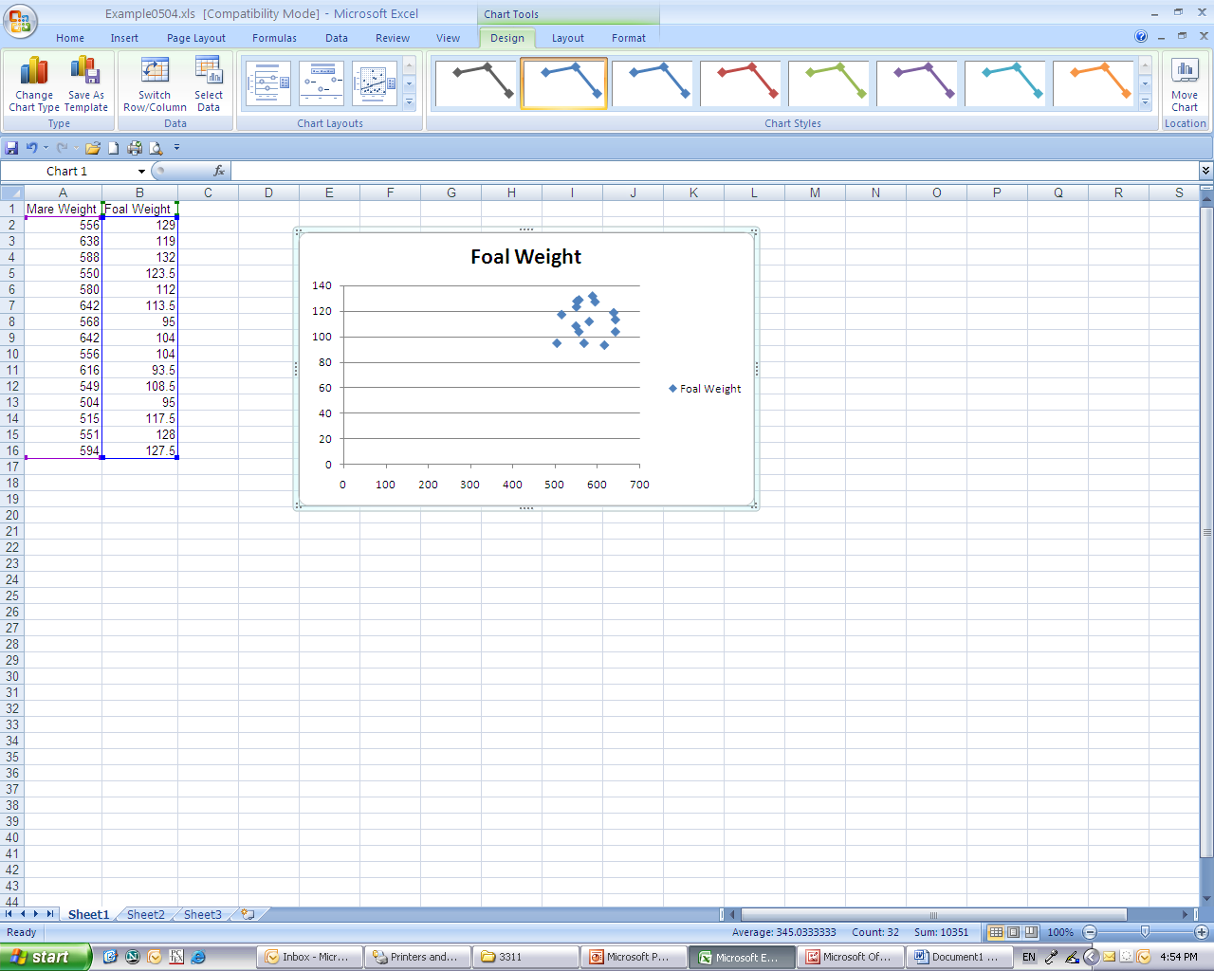
Foal and Mare weight: Scatterplot by Excel
The scatterplot indicates that there is almost no linear relation between foal weight and mare weight.

Slide 34
Exercise: How does the average finish time (in minutes) in a marathon vary with age group for female participants?
Age Group | Representative Age | Average Finish Time
10 – 19 | 15 | 302.38
20 – 29 | 25 | 193.63
30 – 39 | 35 | 185.46
40 – 49 | 45 | 198.49
50 – 59 | 55 | 224.30
60 - 69 | 65 | 288.71
Construct a scatterplot and find r. Is there a strong linear relation between the age and average finish time?
Let x = representative age, and y = average finish time.
r = 0.038477. There is a very weak linear relation between the age and average finish time.

Slide 35
Simple Linear Regression: Fitting a Line to Bivariate Data
Simple regression analysis is to use information about x to draw some sort of conclusion concerning y.
y – the dependent or response variable, and
x – the independent, predictor, or explanatory variable.
If a scatterplot of y versus x exhibits a linear pattern, we can summarize the relationship between the variables by finding a line y = a + bx that is as close as possible to the points on the plot.
a – the y-intercept (the height of the line when x = 0), and
b – the slope (the amount by which y increases when x increases by 1 unit.)

Slide 36
Regression Analysis (overview cont’d)
We will start out by looking at how one variable may explain or predict another
We will later show how to extend this idea to how one variable may have multiple explanatory factors
We will concentrate mainly upon linear relationships
We will later show how to incorporate some non-linearity

Slide 37
Linear relationships
When two variables have a linear relationship, we call them
X = independent variable (horizontal axis)
Y = dependent variable (vertical axis)
and describe the relationship as
Y = a + b*X
where
a = intercept
b = slope
For example,
X = Year
Y = Male Life Expectancy
a = -445.95
b = 0.2608
(see Excel-life expectancy)

Slide 38
Linear Relationships (cont’d)
Y = a + b*X, where a is the intercept and b is the slope
The intercept a is the value of Y when X = 0, or the place on the vertical axis where the line crosses
The slope b describes the pitch or slope of the line
If b > 0, the line goes up from left to right; the variables have a positive relationship; “when X goes up, Y goes up”
If b < 0, the line goes down from left to right; the variables have a negative relationship; “when X goes up, Y goes down”
In regression, we will take two variables X and Y and determine the a and b that best describe the relationship between X and Y
Our starting assumption is that Y is dependent on X

Slide 39
The Principle of Least Squares
The most widely used criterion for measuring the goodness of fit of a line y=a+bx to bivariate data (x₁, y₁), (x₂, y₂), …, (x_{n}, y_{n}) is the sum of the squared deviations about the line
The line that gives the best fit to the data is the one that minimizes this sum. This line is called the least-squares line or the sample regression line.

Slide 40
Example: Time to Defibrillator Shock and Heart Attack Survival Rate
Studies have shown that people who suffer sudden cardiac arrest (SCA) have a better chance of survival if a defibrillator shock is administered very soon after cardiac arrest. The data on the left gives
y = survival rate (%) and
x = mean call-to-shock time (in minutes).
Construct a least-squares line.
x (minutes) | y (%)
2 | 90
6 | 45
7 | 30
9 | 5
12 | 2

Slide 41
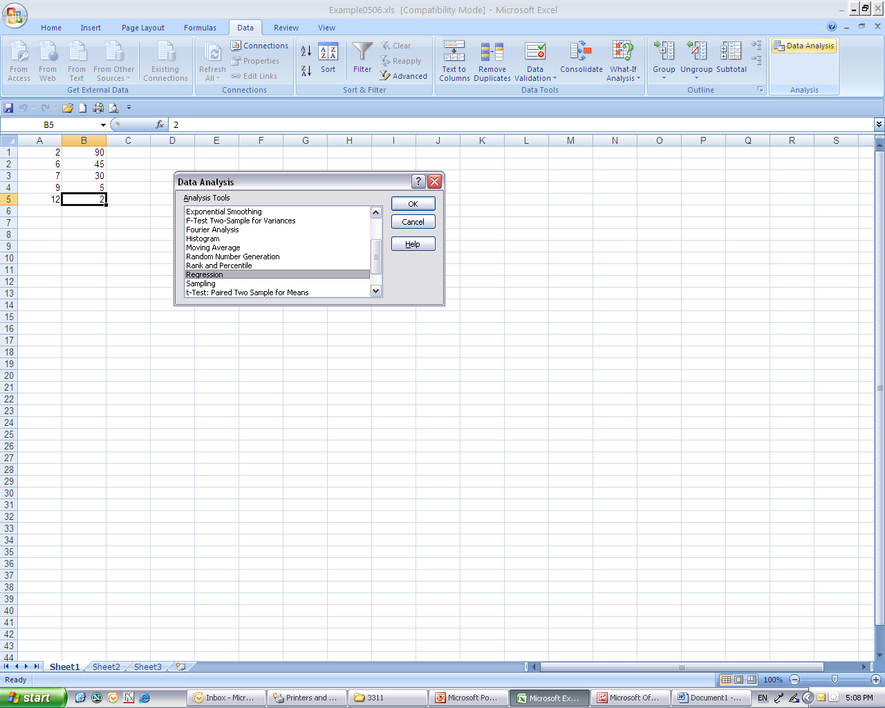
Go to Data Analysis Choose Regression Click OK

Slide 42
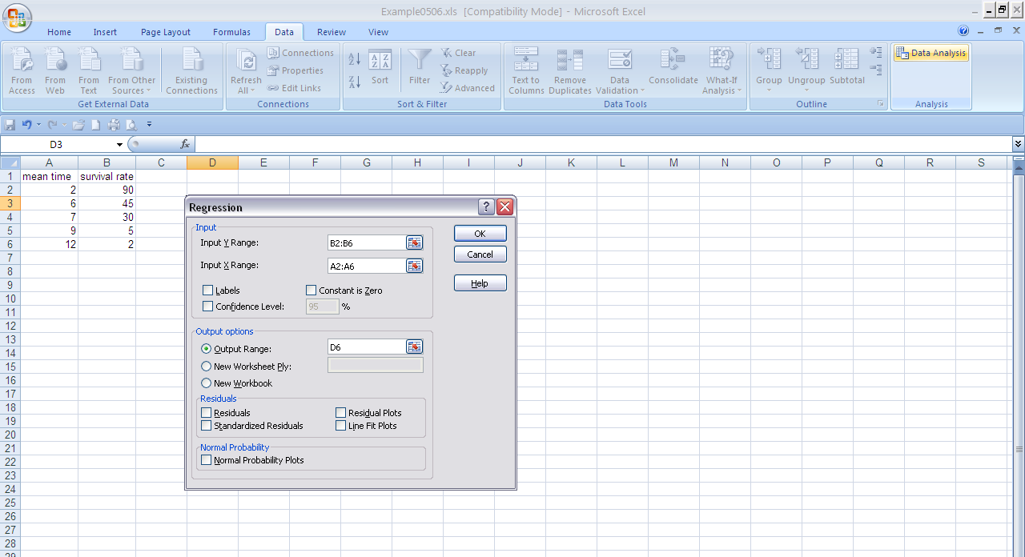
In the dialog box, enter Y Range first (B2:B6) and then X Range (A2:A6). You can optionally choose Output Range.

Slide 43
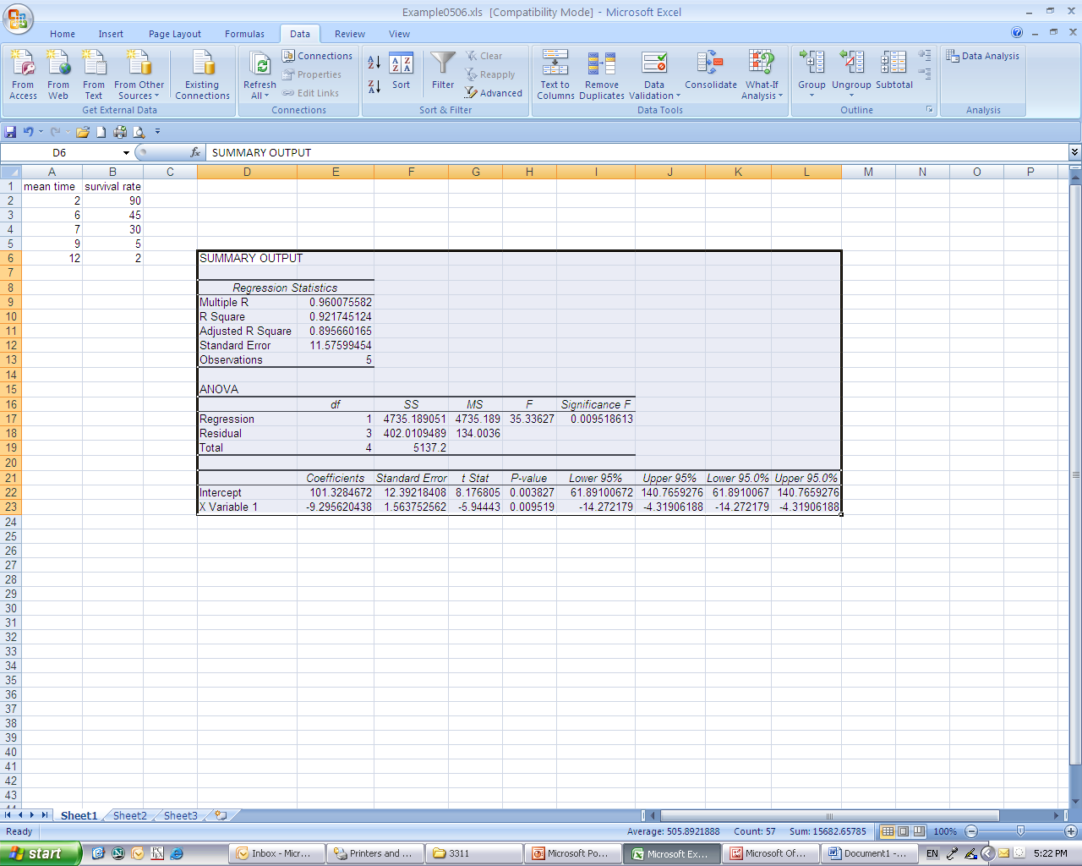
Excel gives a summary with a lot of information. (You may adjust the width of columns to have a better view.) From the data in Coefficients column: a = intercept = 101.33 and b = X Variable 1 = - 9.30.
The least-squares line is ŷ = 101.33 – 9.30x.

Slide 44
Exercise: Is Age Related to Recovery
Time for Injured Athletes?
How quickly can athletes return to their sport following injuries requiring surgery? An article gave the data in the table for 10 weight lifters on
x = age and
y = days after arthroscopic shoulder surgery before being able to return to their sport.
Find the least-squares line. (see age related recovery excel sheet)
x | y
33 | 6
31 | 4
32 | 4
28 | 1
33 | 3
26 | 3
34 | 4
32 | 2
28 | 3
27 | 2
Answer: y = −5.05 + 0.272x

Slide 45
Doing Regression Analysis
Do a scatter diagram on the relevant data
Do the full regression analysis using Excel’s Tools > Data Analysis > Regression command, saving and plotting the residuals
Examine the residuals for individual information (and other trends)

Slide 46
Practical Trends with R square and Standard error
When working with regression, you will often have to compare two separate regressions and try to determine which is a better model. In this case, look for
higher R square and lower Standard error
Regression Statistics
Multiple R | 0.558224
R Square | 0.311614
Adjusted R Square | 0.225566
Standard Error | 1.230629
Observations | 10

Slide 47
Considering Regression Models p-value considerations
If Variables have high p-values---try removing those variables (multiple-regression only)
If Intercept has high p-value----try running regression with intercept set = 0
See Seed Corn Data Regression

Slide 48
Seed Corn Data Regression
Do a Scatterplot with actual sales on the vertical axis and forecasted sales on the horizontal axis
Compute the correlation coefficient between actual and forecasted sales

Slide 49
Seed Corn Data Regression
Do a linear regression using forecasted sales to predict actual sales (eg. forecasted sales is the x-variable).
What does the value of the p-value for the intercept suggest to you?

Slide 50
Confidence Intervals about Point Estimates
If Y is the predicted point estimate value (based on the regression equation) then a (1 – α)% confidence interval is given (approximately) by:
Y + t.inv(1-[α/2], n-2) * Standard error.
Here,
n = # observations upon which the regression is based
Standard error = standard error (reported in summary statistics)
See Seed Corn example

Slide 51
Seed Corn Confidence Interval Example Intercept = 0 Model
Point Estimate, Y is given by:
Y = Predicted actual sales = 0 + 0.793 Forecasted Sales
= 79.3 (thousand) bags
Fenceposts for confidence interval:
Y + tinv(α/2, n-2) * Standard error
Y = ______
n-2 = ______
Se = _______
Lower fencepost: ______ – tinv(.025, ____) x ____ = _____
Upper fencepost: ______ + tinv(.025, ____) x ____ = _____

Slide 52
More about the Regression Output
When you use the least squares method to perform a regression analysis, here is a very important fact:
the mean of all residuals equals 0

Slide 53
More on the Regression Output (cont’d)
In a regression, what does a slope coefficient of 0 mean?
It means that X has no effect on Y at all
The regression output gives a 95% confidence interval for the slope coefficient:
if 0 is outside the interval, then we are confident that the slope is not 0
if 0 is inside the interval, then the slope may be 0
P-value (or Prob-value) is
“the probability that 0 is the real slope coefficient”
Generally speaking, to make inferences from the regression, you want the P-value to be small (less than 0.05)

Slide 54
A good regression model has…
A high R² value
A low S_{e} value
Slope coefficient which is not likely to equal 0
0 is outside the 95% confidence interval
P-values less than 0.05
Intercept is significant (low p-value) or close to zero
So then what makes a bad model?

Slide 55
A bad regression model has…
Residuals that are not very well distributed
overall
residual histogram should look normal
for each section of values of X
residual plot should not have any strong patterns
e.g., mean of section’s residuals should equal 0 (like entire model)
for each subcollection of non-biased sample data
mean of subcollection’s residuals should equal 0 (mean of ALL residuals = 0)
Variance of subcollections residuals should equal variance of ALL residuals
in other words, we want no systematic misprediction
The linear idea just doesn’t fit the situation
Do you have strong reason to believe that Y and X are not related by a line?

Slide 56
A bad regression model has… (cont’d)
Is the distribution of residuals non-normal?
Is the linear model inappropriate?
When one of these is “yes” and the difference from the ideal model is striking, then linear regression is probably not a good idea
When one of these is “yes” but the difference from the ideal model is moderate, then maybe the linear regression can be improved…
(see Excel, female marathoners, air passenger miles)

Slide 57
Female Marathoners
Linear Model does not fit
But, can fit a polynomial model
y = a x ² + b x + c
3 columns: y values, x values, and x² values
Set y values = dependent variable
Set x values and x² values = independent variables

Slide 58
Air Passenger Miles Model
Does the histogram of residuals look like a normal distribution?
What about the averages over subcollections of residuals?

Slide 59
Examining Residuals
Sum/Avg of subcollections should be close to zero-----use pivot table & grouping to examine…
Residuals should be normally distributed: use pivot table/chart to create histogram of residuals

Slide 60
Using Pivot Table to Create a Histogram
Highlight residual data
Insert Pivot table
Drag “residuals” to the “Row Labels” box
Drag “residuals to the “∑ values” box
Left click on the “sum of residuals bar” in the “∑ values” box
Click on “value field settings” in the dialog box that opens
Click on “count” in the new dialog box

Slide 61
Count of Residuals
Residuals | Total
-3083.195551 | 1
-2874.951279 | 1
-2805.114572 | 1
-2574.624694 | 1
-2350.298109 | 1
-2237.665184 | 1
-2127.032258 | 1
-2126.338598 | 1
-1593.991769 | 1
-1476.787987 | 1
-1296.155061 | 1
-984.4614016 | 1
-876.501891 | 1
-588.5221357 | 1
-414.4411568 | 1
-237.6044494 | 1
-157.8284761 | 1
-104.6854283 | 1
686.2322581 | 1
756.1512792 | 1
1093.641157 | 1
1636.722136 | 1
1712.518354 | 1
1929.191769 | 1
2162.355061 | 1
2239.987987 | 1
3691.028476 | 1
3733.824694 | 1
3821.681646 | 1
4446.865184 | 1
Grand Total | 30
Air Passenger Residual Pivot Chart

Slide 62
Using Pivot Table to Create a Histogram
Highlight one of the entries in the first column (residuals) in the resulting pivot table
Right click on the highlighted entry and choose “group” from the resulting dialog box.
Group the entries as you wish
Count of Residuals
Residuals | Total
-3083.195551 | 1
-2874.951279 | 1
-2805.114572 | 1
-2574.624694 | 1

Slide 63
Air Passenger Residual Pivot Chart
After Grouping
(I grouped from -3100 to 4500 by 1000)
Count of Residuals
Residuals | Total
-3100--2100 | 8
-2100--1100 | 3
-1100--100 | 7
-100-900 | 2
900-1900 | 3
1900-2900 | 3
2900-3900 | 3
3900-4900 | 1
Grand Total | 30

Slide 64
Using Pivot Table to Create a Histogram
Click on “pivot table tools” (tab above the formula bar)
Choose pivot chart --- see Excel for example

Slide 65
Using Pivot Table to Group Residuals into Sub-collections
Highlight residual data
Insert Pivot table
Drag “observation” (or whatever other field you wish to group by) to the “Row Labels” box
Drag “residuals to the “∑ values” box
Left click on the “sum of residuals bar” in the “∑ values” box
Click on “value field settings” in the dialog box that opens
Click on “average” in the new dialog box

Slide 66
Average of Residuals
Observation | Total
1 | -2127.032258
2 | -3083.195551
3 | 1093.641157
4 | -588.5221357
5 | -104.6854283
6 | 756.1512792
7 | 2239.987987
8 | 3733.824694
9 | -2126.338598
10 | -876.501891
11 | -2237.665184
12 | -157.8284761
13 | -1593.991769
14 | -1296.155061
15 | 3821.681646
16 | 1712.518354
17 | 2162.355061
18 | 1929.191769
19 | 3691.028476
20 | 4446.865184
21 | -2350.298109
22 | -984.4614016
23 | -2574.624694
24 | -1476.787987
25 | -2874.951279
26 | -2805.114572
27 | 1636.722136
28 | -414.4411568
29 | -237.6044494
30 | 686.2322581
Grand Total | -2.42532E-12
Using Pivot Table to Group Residuals into Sub-collections
This is ungrouped pivot table

Slide 67
Using Pivot Table to Examine Sub-collections
Highlight one of the entries in the first column (observation) in the resulting pivot table
Right click on the highlighted entry and choose “group” from the resulting dialog box.
Group the entries as you wish
Average of Residuals
Observation | Total
1 | -2127.032258
2 | -3083.195551
3 | 1093.641157
4 | -588.5221357
5 | -104.6854283

Slide 68
Using Pivot Table to Examine Sub-collections---grouped by 5
Averages should all be close to zero for a good regression
What kind of statistical test could we use to test whether an average is statistically different from zero?
Average of Residuals
Observation | Total
1-5 | -961.9588432
6-10 | 745.4246941
11-15 | -292.7917686
16-20 | 2788.391769
21-25 | -2052.224694
26-30 | -226.8411568
Grand Total | -2.42532E-12

Slide 69
Multiple Linear Regression
Multiple linear regression is very similar to simple linear regression except that the dependent variable Y is described by m independent variables X₁, …, X_{m}
Y = a + b₁*X₁ + … + b_{m}*X_{m}

Slide 70
Multiple Linear Regression (cont’d)
Y = a + b₁X₁ + … + b_{m}X_{m}
Intercept a is the same
Slope b_{i} is the change in Y given a unit change in X_{i} while holding all other variables constant
Interpretations of R² & Std. error are the same
Slope coefficient C.I.s (one for each X_{i}) are the same
P-values for slope coefficients & intercept are the same

Slide 71
Fitting Polynomials
See female marathon times worksheet

Slide 72
Artsy—from HW #8
Regression of RATE on SEX, GRADE, and TINGRADE:
RATE = 177 + 21.8 SEX + 24.7 GRADE + 10.1 TINGRADE

Slide 73
Dummy Variables
Dummy variables
are variables that only take on the values 0 or 1
can be used as a tool to put variables that do not have a natural numerical interpretation into a regression
For example, sex variable is 0 for female, 1 for male
For example, dummy variables can also be used to fix a problem with using GRADE as a variable in the Artsy example….

Slide 74
Dummy Variables (cont’d)
Artsy example:
introduce a variable Gk for each grade,
1 if in grade, 0 if not
Grade / Variable | G1 | G2 | G3 | G4 | G5 | G6 | G7 | G8
Grade 1 | 1 | 0 | 0 | 0 | 0 | 0 | 0 | 0
Grade 2 | 0 | 1 | 0 | 0 | 0 | 0 | 0 | 0
Grade 3 | 0 | 0 | 1 | 0 | 0 | 0 | 0 | 0
Grade 4 | 0 | 0 | 0 | 1 | 0 | 0 | 0 | 0
Grade 5 | 0 | 0 | 0 | 0 | 1 | 0 | 0 | 0
Grade 6 | 0 | 0 | 0 | 0 | 0 | 1 | 0 | 0
Grade 7 | 0 | 0 | 0 | 0 | 0 | 0 | 1 | 0
Grade 8 | 0 | 0 | 0 | 0 | 0 | 0 | 0 | 1

Slide 75
Dummy Variables (cont’d)
You must choose a “base case”;
in this case Grade 1 is a good base case, which means we should delete the variable G1
Grade / Variable | G2 | G3 | G4 | G5 | G6 | G7 | G8
Grade 1 | 0 | 0 | 0 | 0 | 0 | 0 | 0
Grade 2 | 1 | 0 | 0 | 0 | 0 | 0 | 0
Grade 3 | 0 | 1 | 0 | 0 | 0 | 0 | 0
Grade 4 | 0 | 0 | 1 | 0 | 0 | 0 | 0
Grade 5 | 0 | 0 | 0 | 1 | 0 | 0 | 0
Grade 6 | 0 | 0 | 0 | 0 | 1 | 0 | 0
Grade 7 | 0 | 0 | 0 | 0 | 0 | 1 | 0
Grade 8 | 0 | 0 | 0 | 0 | 0 | 0 | 1

Slide 76
A Basic Technique for Multiple Linear Regression
Regression analysis is all about trying to determine what variables have an effect on a single variable
In other words, you are trying to describe Y in terms of X₁, …, X_{m}
Some of the variables may not have a significant effect (which corresponds to a high P-value for the corresponding slope coefficient)
Efficiency: Adding in variables is okay, but remove the ones that don’t have a significant effect on Y

